Slide 1
Train Machine Learning model with Auto-ML and put it into Production Environment
Muhammad Rehman Zafar
Ryerson Multimedia Research Laboratory (RML), Ryerson University

Slide 2
Agenda
Introduction
Classical Machine Learning
Auto Machine Learning
Train Auto Machine Learning model
Deploy Machine Learning model
Conclusion

Slide 3
Classical Machine Learning
Machine learning is a branch of artificial intelligence (AI)
Automatically learn and improve from experiences
Allow algorithms to learn automatically without human intervention
Broadly categorized into two main categories:
Supervised Machine Learning
Unsupervised Machine Learning

Slide 4
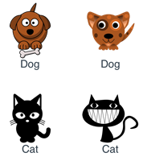
Supervised Machine learning
Uses labeled datasets
Dataset comes with a tag
Dataset must have a target/class variable.
Examples are Regression and Classification
https://livebook.manning.com/book/grokking-machine-learning/2-1-what-is-the-difference-between-labelled-and-unlabelled-data-/v-4/40

Slide 5

Unsupervised Machine Learning
Uses unlabeled datasets
Dataset doesn’t have any tag
Dataset doesn’t have target/class variable
Examples are clustering and association rules
https://livebook.manning.com/book/grokking-machine-learning/2-1-what-is-the-difference-between-labelled-and-unlabelled-data-/v-4/40

Slide 6
Auto Machine Learning (Auto-ML)
Progressive automation of Machine Learning
A wrapper around machine learning algorithms
Works on the same vein
Automating the end-to-end process of applying machine learning to real world problems
But has certain advantages over classical machine learning
Focuses on end users without expert knowledge
Doesn't require hand crafted feature engineering
Doesn’t require parameter tuning
Reduces the human effort
Takes the input data and provides the optimized model

Slide 7
Why Auto-ML?
Auto train models
Auto tune hyperparameters and feature selection
Very handy to define benchmarks
Eliminating human errors
Less human effort
Faster development

Slide 8
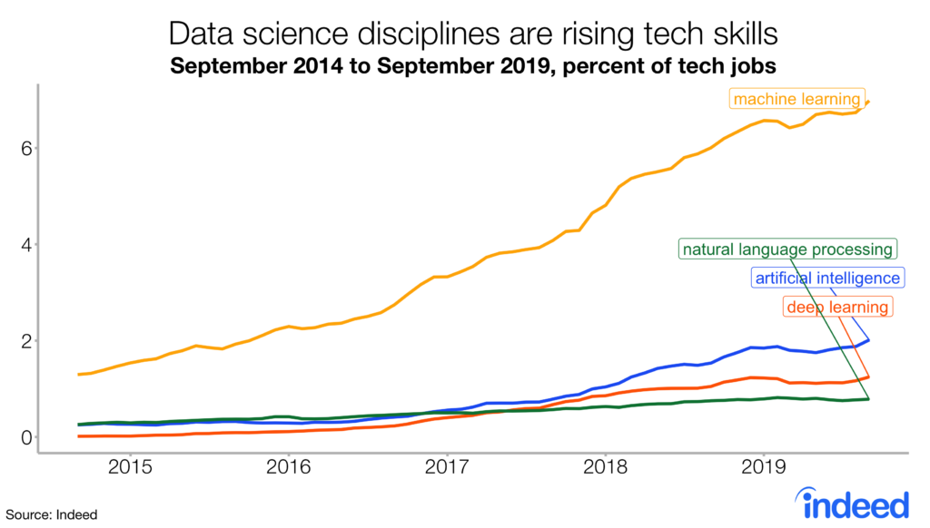
Fastest Growing Tech

Slide 9
Auto-ML Frameworks
Tree-based pipeline optimization (TPOT) [3]
Auto-sklearn [4]
H2O.ai [5]
AutoKeras [6]
AutoWeka [7]
Google Cloud AutoML [8]
Azure AutoML [9]

Slide 10
Auto-ML with TPOT
Uses genetic programming
Start with random pipelines
Best of every generation will mutate or cross-over
Once TPOT is finished searching (or you get tired of waiting), it provides you with the Python code for the best pipeline

Slide 11
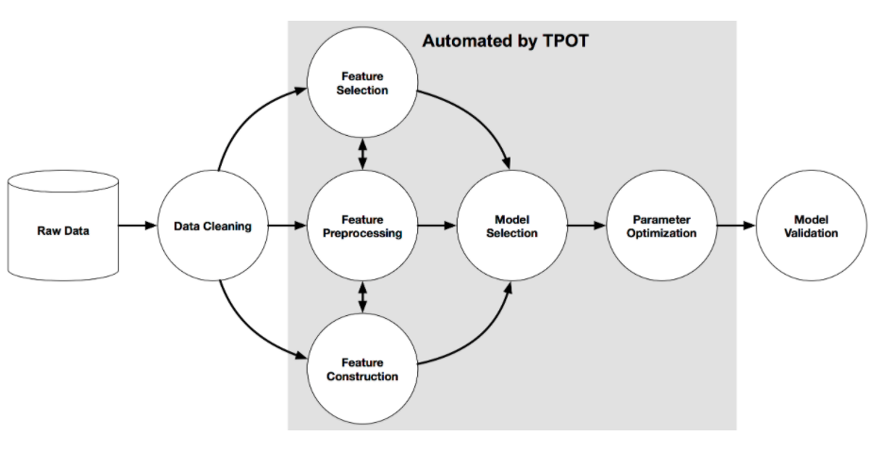
Auto-ML Pipeline
http://epistasislab.github.io/tpot/

Slide 12
Let’s build a model with TPOT

Slide 13
What’s Next?
Deploy a model in production
There are mainly two approached to deploy a model
Deploy it on your own server and write a Rest API to invoke it
Deploy it on a Cloud Servers
E.g. Microsoft Azure, Amazon Web Services (AWS) and Google Cloud Platform (GCP) etc.

Slide 14
Deployment Resources for Microsoft Azure
Compute target | Used for | Description
Local Web Service | Testing/debugging | Limited for testing and debugging
Azure Kubernetes Service (AKS) | Real-time inference | GPU support, Use for high-scale production deployments
Azure Container Instances | Testing or development | Use for low-scale CPU-based workloads
Azure Machine Learning compute clusters | Batch inference | Run batch scoring on serverless compute.
https://docs.microsoft.com/en-us/azure/machine-learning/service/how-to-deploy-and-where

Slide 15
Other Useful Resources for Model Deployment
Deploy Tensorflow Model as a Web Service at Microsoft Azure
https://www.linkedin.com/pulse/deploy-tensorflow-model-web-service-microsoft-azure-zafar/
Create, review, and deploy automated machine learning models with Azure Machine Learning
https://docs.microsoft.com/en-us/azure/machine-learning/how-to-use-automated-ml-for-ml-models
Deploy your existing model with Azure Machine Learning
https://docs.microsoft.com/en-us/azure/machine-learning/how-to-deploy-existing-model
Tutorial: Forecast demand with automated machine learning
https://docs.microsoft.com/en-us/azure/machine-learning/tutorial-automated-ml-forecast

Slide 16
Conclusion
Auto-ML algorithms aren't intended to run for only a few minutes
TPOT can take a long time to finish its search
TPOT can recommend different solutions for the same dataset
TPOT will work better when you give it more generations

Slide 17
References
Trang T. Le, Weixuan Fu and Jason H. Moore (2020). Scaling tree-based automated machine learning to biomedical big data with a feature set selector. Bioinformatics.36(1): 250-256.
Collier, Michael, and Robin Shahan. Microsoft Azure Essentials-Fundamentals of Azure. Microsoft Press, 2015.
http://epistasislab.github.io/tpot/
https://automl.github.io/auto-sklearn/master/
https://www.h2o.ai/products/h2o-driverless-ai/
https://autokeras.com/
https://www.cs.ubc.ca/labs/beta/Projects/autoweka/
https://cloud.google.com/automl
https://azure.microsoft.com/en-ca/services/machine-learning/automatedml/

Slide 18
Thank you!
https://github.com/rehmanzafar/SeminarTalk-F20

